Slide 1
Psychometrics: An Introduction, Fourth Edition
Chapter 12: Confirmatory Factor Analysis

Slide 2
Introduction
Key implications for test’s development, reliability, validity, and use.
Exploratory factor analysis: evaluates a test’s dimensionality.
Confirmatory factor analysis: examines a test’s dimensionality.
Notes:
Key implications for test’s development, reliability, validity, and use:
Test development: Internal structure is considered majorly when constructing a new test or scale.
Reliability: Evaluation of a test’s dimensionality reveals which items are consistent with which other items.
Validity: A test’s internal structure is important because the appropriate interpretation of scores depends on the match between its actual and intended internal structures.
Use: Internal structure must guide the way a test is scored, producing one or more psychologically and quantitatively meaningful scores.
Exploratory factor analysis (EFA):
A statistical tool used to evaluate a test’s dimensionality.
Most appropriate with few hypotheses about a scale’s internal structure.
Confirmatory factor analysis (CFA):
Designed to examine a test’s dimensionality when there are clear expectations about the number of factors or dimensions underlying a test’s items, the links between the items and factors, and the association between the factors.
Uses of confirmatory factor analysis:
It examines various crucial psychometric issues.
It examines a test’s internal consistency.
It evaluates convergent and discriminant evidence.

Slide 3
On the Use of EFA and CFA (1 of 2)
The Frequency and Roles of EFA and CFA
EFA is used more frequently than CFA.
Emerging interest and application of CFA.
EFA and CFA useful for different phases of test development.
Hypothesis-driven versus exploratory approach.
Notes:
EFA is used more frequently than CFA:
This discrepancy is a result of seamless integration of EFA into user-friendly and widely used statistical packages.
Example: While EFA has long been integrated into the popular SPSS statistical package, the ability to conduct CFA in SPSS emerged later and still requires additional software components.
Emerging interest and application of CFA:
This emergence might be due to the growing availability and user-friendliness of statistical software that is capable of conducting CFA.
Statistical packages such as R, SAS, Mplus, and SPSS are relatively straightforward for CFA and include modules that conduct CFA.
Example: When using the AMOS package in SPSS, CFA can be conducted by only creating figures to represent hypotheses about a test’s dimensionality.
EFA and CFA useful for different phases of test development: While EFA is most useful when test developers clarify their understanding of the constructs and of the test itself, CFA is more useful after the initial evaluations of item properties and dimensionality and after significant revisions of test content.
Hypothesis-driven versus exploratory approach:
While EFA is used in a hypothesis-driven way, CFA is often used in an exploratory way.
The technique of exploratory structural equation modeling blends both exploratory and confirmatory factor-analytic procedures, with benefits of both methods.

Slide 4
On the Use of EFA and CFA (2 of 2)
Using CFA to Evaluate Measurement Models
Understanding the degree of consistency.
Altering hypothesized model to be consistent.
Examining measurement models in a series of CFAs.
Notes:
Understanding the degree of consistency:
With CFA, test developers and evaluators can understand the degree to which their hypothesized measurement models are consistent with actual data.
Example: If we hypothesize that the RSEI has a unidimensional structure, we can test this “model” formally using CFA, by collecting responses to the RSEI items and examining the degree to which those actual responses produce data in which the RSEI items cohere into a single factor.
Altering hypothesized model to be consistent:
It is possible to alter our hypothesized model to make it more consistent with the actual structure of responses to the test.
Example: If the CFA of the RSEI indicates that the actual responses are not consistent with a unidimensional model, we can modify our hypothesis regarding the true structure of the RSEI.
Examining measurement models in a series of CFAs:
This can be done using the results to discover the one that best matches participants’ actual responses.
Example: By formally testing the RSEI’s “fit” with both a unidimensional model and a two-dimensional model, we can find which model is more consistent with the actual test responses.

Slide 5
The Process of CFA for Analysis of a Scale’s Internal Structure
(1 of 15)
Overview of CFA and an Example
CFA: an iterative, back-and-forth process.
Key information reported about model-testing process.
Example of the Authenticity Scale.
Notes:
CFA: an iterative, back-and-forth process:
The process begins with articulation and evaluation of a specific measurement model.
Then, the model is revised and the revised model is evaluated.
Revision and reevaluation of models can occur multiple times as we learn more and more from the CFA process.
Key information reported about model-testing process:
It includes any revisions that have been made to the model(s).
It highlights the measurement model that is most consistent with the test’s actual internal structure.
Example of the Authenticity Scale:
This scale was intended to measure the degree to which a person “knows himself or herself” and “acts accordingly.”
It was based on a model that identifies three dimensions of authenticity.

Slide 6
The Process of CFA for Analysis of a Scale’s Internal Structure
(2 of 15)
Overview of CFA and an Example
Three dimensions of authenticity:
  Self-alienation: degree of knowing oneself.
  Authentic living: degree of expressing emotions honestly.
  Accepting external influence: degree of knowing influence of others.
Notes:
Three dimensions of authenticity:
Self-alienation:
The degree to which a person really understands himself or herself.
Example: I don’t know how I really feel inside.
Authentic living:
The degree to which a person behaves and expresses emotion in a way that is an honest reflection of his or her self-perception.
Example: I think it is better to be yourself than to be popular.
Accepting external influence:
The degree to which a person understands that other people can influence one’s life and conforms to these influences.
Example: I am strongly influenced by the opinions of others.

Slide 7
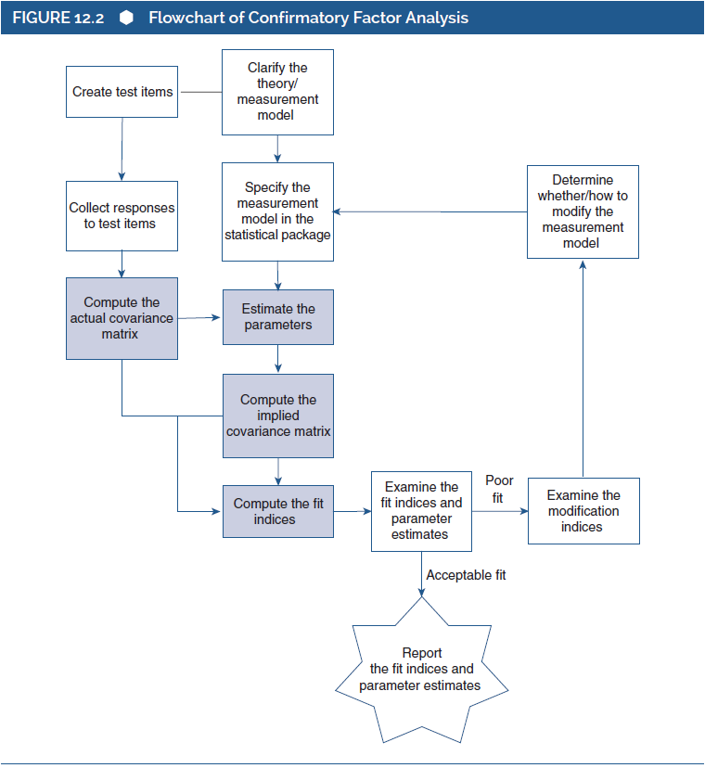
The Process of CFA for Analysis of a Scale’s Internal Structure
(3 of 15)
Overview of CFA and an Example
Notes:
Figure 12.2: Flowchart of confirmatory factor analysis.

Slide 8
The Process of CFA for Analysis of a Scale’s Internal Structure
(4 of 15)
Preliminary Steps
Clarification of psychological construct and initial development of test.
Collection of large number of responses to test.
Reverse scoring of negatively keyed items.
Notes:
Clarification of psychological construct and initial development of test:
This is the first preliminary step.
Wood et al. described a process of writing a large number of items, an initial analysis of some responses to those items, and a selection of four items for each of the three intended dimensions, which produced a total of 12 items that passed initial tests of psychometric quality.
Collection of large number of responses to test:
A variety of recommendations have been offered by experts for the sample size of a CFA.
For absolute numbers of respondents, recommendations range from a minimum of 50 people to 400 people or more.
For the ratio of respondents to items, suggestions range from 5 respondents per item to 20 or more respondents per item.
As a complex multivariate procedure, CFA requires a large number of responses (i.e., more than 200 respondents).
Reverse scoring of negatively keyed items:
This ensures that every item is keyed in the same direction.
It avoids any confusion arising from items that might otherwise seem highly inconsistent with each other.

Slide 9
The Process of CFA for Analysis of a Scale’s Internal Structure
(5 of 15)
Preliminary Steps: Step 1: Specification of the Measurement Model
Using statistical software package to conduct CFA.
Elements to be specified in the model.
Specifying hypothesis for existence of link/association.
Notes:
Using statistical software package to conduct CFA:
Once the three preliminary steps are performed, the hypothesized measurement model is transferred into a statistical software package designed to conduct CFA.
The process can be straightforward with the use of packages such as AMOS/SPSS, SAS, EQS, LISREL, Mplus, or R.
Some of these packages allow us simply to draw a figure to represent the measurement model and these drawings are translated into statistical equations, which are used to conduct the CFA.
We can also create those equations directly using these packages without having to draw a figure.
Elements to be specified in the model:
The number of dimensions, factors, or latent variables that are hypothesized to underlie the test’s items.
The links between items and factors.
Guidelines followed when specifying links:
In most measurement models, at least one item is linked to each factor.
Each item is typically linked to only one latent variable since the item reflects only one psychological characteristic.
The potential associations between factors (if more than one factor is hypothesized).
Two ways of indicating that factors are associated with each other:
Specifying that the factors load on a higher order factor.
Having factors be correlated with each other by using a two-way arrow between them.
Specifying hypothesis for existence of link/association:
We hypothesize that an item is associated with a particular factor or not.
We also hypothesize that factors are associated with each other or not.
The statistical software will then estimate the precise associations.
If there is a pathway between an item and a factor (or between two factors), then it indicates a hypothesized nonzero association.
Conversely, if the pathway is absent, it indicates a hypothesized zero association.

Slide 10
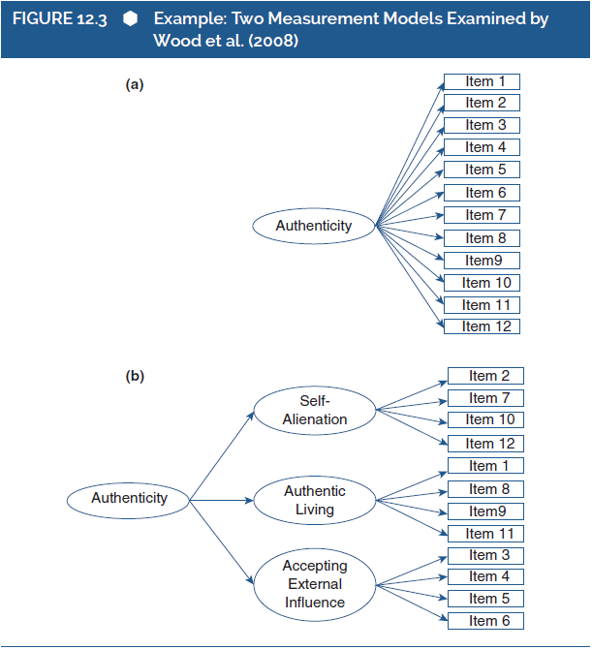
The Process of CFA for Analysis of a Scale’s Internal Structure
(6 of 15)
Preliminary Steps: Step 1: Specification of the Measurement Model
Notes:
Figure 12.3: Example: Two measurement models examined by Wood et al. (2008).

Slide 11
The Process of CFA for Analysis of a Scale’s Internal Structure
(7 of 15)
Preliminary Steps: Step 2: Computations
Phase 1: actual variances and covariances.
Phase 2: parameter estimates and inferential tests.
Key types of parameters to be estimated.
Weak and strong factor loadings.
Notes:
Phase 1: Actual variances and covariances:
In this phase, the items’ variances and the covariances among the items are computed using the collected data.
This means that the software computes the actual degree of variance for each item and the actual level of covariance between each pair of items.
Example: In the analysis of the Authenticity Scale, 12 variances and 66 covariances are computed and these values are used in subsequent phases.
Phase 2: Parameter estimates (and inferential tests):
In this phase, values for the “parameters” are estimated using the items’ actual variances and covariances.
Parameters: Quantitative values related to specific elements of the measurement model; an important part of the results produced by CFA.
Key types of parameters to be estimated:
Item–factor parameters:
The factor loadings for each item.
When hypothesizing that an item loads on a factor, we usually rely on the statistical software to compute a value for that parameter.
Factor–factor parameters:
Factors that connect factors to each other, either correlations between factors or the loading of lower order factors on higher order factors.
When hypothesizing that one factor loads on another or two factors are correlated, the software will compute parameter estimates for the loadings or correlation.
Weak and strong factor loadings:
If the actual covariance between two items are strong, then they might have something strongly in common with each other; thus, the statistical software might compute strong loadings for both items on a factor, which they would have in common.
If the actual covariance between two items is weak, then they do not have anything strongly in common with each other; thus, the statistical software might compute a weak factor loading for at least one of those items.

Slide 12
The Process of CFA for Analysis of a Scale’s Internal Structure
(8 of 15)
Preliminary Steps: Step 2: Computations
Phase 3: implied variances and covariances.
Problem of balancing huge amount of information.
Match/mismatch between actual and implied variances and covariances.
Notes:
Phase 3: Implied variances and covariances:
In this phase, the estimated parameter values are used to compute “implied” item variances and covariances.
This means that the software computes item variances and covariances, as implied by the estimated parameters.
Problem of balancing huge amount of information:
There can be substantial mismatches between actual and implied variances/covariances due to the fact that the software must balance and weigh a huge amount of information when computing each and every parameter estimate.
Sometimes, the software’s attempt to balance huge amount of information does not work well.
When attempting to find solutions to this problem, the CFA might sometimes produce parameter estimates that don't serve good representations of each single piece of information.
Match/Mismatch between actual and implied variances and covariances:
If the hypothesized model is good, then the implied variances and covariances will match closely the actual variances and covariances.
If the model is poor, then the implied values will differ greatly from the actual values.

Slide 13
The Process of CFA for Analysis of a Scale’s Internal Structure
(9 of 15)
Preliminary Steps: Step 2: Computations
Phase 4: indices of model fit.
Condition of good fit indices.
Condition of poor fit indices.
Modification indices: ways of improving measurement models.
Notes:
Phase 4: Indices of model fit:
In this phase, information about the general adequacy or “fit” of the hypothesized model is produced by the software.
This is done by comparing the implied variances/covariances with the actual variances/covariances.
Condition of good fit indices:
Occurs if only minor discrepancies or mismatches are found when comparing implied and actual values.
Indicates that the hypothesized measurement model reflects the actual pattern of the test responses.
Condition of poor fit indices:
Occurs if large discrepancies or mismatches are found when comparing implied and actual values.
Indicates that the hypothesized measurement model does not reflect the actual pattern of the test responses.
Modification indices:
These values indicate specific ways of improving measurement models.
They reveal potential modifications that would bring the model closer to the factor structure that may be underlying the test’s items.

Slide 14
The Process of CFA for Analysis of a Scale’s Internal Structure
(10 of 15)
Preliminary Steps: Step 3: Interpreting and Reporting Output
Examining the fit indices.
Calis procedure of statistical package SAS.
Chi-square statistic: misfit of the model.
Alternative indices of chi-square statistic.
Notes:
Examining the fit indices:
These indices address the overall adequacy of our hypothesized measurement model.
If the fit indices are good, then we can have initial confidence in interpreting the dimensionality of the test as we hypothesized.
If the fit indices are poor, then it indicates that the hypothesized measurement model is not consistent with the actual responses to the test.
Calis procedure of statistical package SAS:
It computes approximately 20 fit indices.
It is used to conduct CFA.
Chi-square statistic:
The most commonly reported fit index.
Range: greater than or equal to 0.
Indicates the degree of “poorness of fit” or “misfit” of the model.
Large, significant chi-square values are evidence of poor fit, whereas small, nonsignificant chi-square values indicate good fit.
Affected by the sample size where large sample size would result in poor fit.
Alternative indices of chi-square statistic:
Goodness-of-fit index (GFI).
The incremental fit index (IFI).
The normed fit index (NFI).
The comparative fit index (CFI): ranges from 0 to 1.0; larger values indicate good fit.
The nonnormed fit index (NNFI or the Tucker-Lewis Index, or TLI): ranges from 0 to 1.0; larger values indicate good fit.
The root mean square error of approximation (RMSEA): ranges from 0 to 1.0; smaller values indicate good fit.
The root mean square residual (RMR): range: greater than or equal to 0; smaller values indicate good fit.
The standardized root mean square residual (SRMR): ranges from 0 to 1.0; lower values indicate good fit.
The Akaike information criterion (AIC).

Slide 15
The Process of CFA for Analysis of a Scale’s Internal Structure
(11 of 15)
Preliminary Steps: Step 3: Interpreting and Reporting Output
Table 12.3: Fit indices for two measurement models examined by Wood et al. (2008): Sample 3 (N = 213).
Fit Index | Figure 12.3b | Figure 12.3a | Cited Benchmark
Chi-square | 90.06^{*a} | 353.45^{*b} | NA
SRMR | .08 | .16 | <.08
CFI | .94 | .53 | >.95
RMSEA | .06 | .16 | <.06
Notes:
Table 12.3: Fit indices for two measurement models examined by Wood et al. (2008): Sample 3 (N = 213).
Note: Benchmarks are those cited by Wood et al. (2008). NA = No benchmark cited, as it is the statistical significance of the chi-square test that is used to evaluate model fit; SRMR = standardized root mean square residual; CFI = comparative fit index; RMSEA = root mean square of approximation.
*p <.05.
ªdf = 51.
^{b}df = 54.

Slide 16
The Process of CFA for Analysis of a Scale’s Internal Structure
(12 of 15)
Preliminary Steps: Step 3: Interpreting and Reporting Output
Parameter estimates and significance tests.
Cases of retaining and removing items.
Reason for having well-fitting model but weak factor loading.
Notes:
Parameter estimates and significance tests:
In this step, an estimated value for each parameter is obtained, including values for the factor loadings of items and interfactor associations.
Parameter estimates are vital for determining a test’s overall dimensionality and other psychometric properties.
Cases of retaining and removing items:
If we hypothesize an item to load on a particular factor and if we find a large, positive, and statistically significant factor loading, then we might keep that item on the test.
If we find a small and/or nonsignificant factor loading, then we might remove the item from the test.
In this case, we might respecify the model to accommodate this change and rerun the computations to evaluate the revised test.
Reason for having well-fitting model but weak factor loading:
Fit indices represent the overall adequacy or fit of the entire measurement model.
Hence, a model can have good overall fit despite having some weak specific aspects.

Slide 17
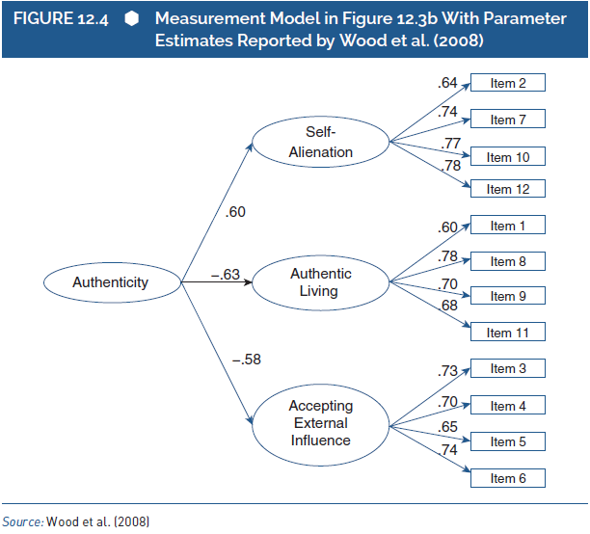
The Process of CFA for Analysis of a Scale’s Internal Structure
(13 of 15)
Preliminary Steps: Step 3: Interpreting and Reporting Output
Notes:
Figure 12.4: Measurement model in Figure 12.3b with parameter estimates reported by Wood et al. (2008).
Source: Wood et al. (2008).

Slide 18
The Process of CFA for Analysis of a Scale’s Internal Structure
(14 of 15)
Preliminary Steps: Step 4: Model Modification and Reanalysis (If Necessary)
Obtaining and examining modification indices.
Analyzing and evaluating revised model.
Cautions regarding modification in a CFA.
Drawback of revising the test.
Notes:
Obtaining and examining modification indices:
Obtaining the modification indices:
When we conduct a CFA, a large number of modification indices is obtained.
Each index represents a parameter that was left out of the initial measurement model.
Examining the modification indices:
The magnitude of a modification index reflects the potential impact of revising or modifying the relevant parameter.
When we examine the modification indices and make changes based on the largest indices, we learn about the real dimensionality of the test.
Analyzing and evaluating revised model:
Analysis will produce new output which includes new fit indices, new parameter estimates, and so on.
We then evaluate the adequacy of the revised model, and we either examine parameter estimates (if the revised model fits well) or examine the new modification indices (if the model still fits poorly).
Cautions regarding modification in a CFA:
It obscures the difference between confirmatory analysis and exploratory analysis.
A test developer or test evaluator might be hesitant to perform many modifications, particularly to those that lack a clear conceptual justification.
Drawback of revising the test: This requires us to collect completely new data from a new set of respondents thereby extending the test development and validation process.

Slide 19
The Process of CFA for Analysis of a Scale’s Internal Structure
(15 of 15)
Comparing Models
Identifying better model by comparing.
Strong insight into test’s actual properties.
Notes:
Identifying better model by comparing: By evaluating and comparing competing measurement models, we can identify which model is the better representation of the test’s true internal structure.
Strong insight into test’s actual properties:
By comparing several reasonable potential measurement models, we can identify the model that has the most supportive fit indices and conclude that it reflects the test’s true dimensionality.
This can provide strong insight into the test’s actual properties.

Slide 20
CFA and Reliability (1 of 7)
Evaluating Types of CTT Measurement Models
Models reflecting links between tests or subtests.
Testing and comparing series of models:
  Step 1: evaluate whether congeneric model fits test data.
Notes:
Models reflecting links between tests or subtests: parallel tests, tau-equivalent tests, essentially tau-equivalent tests, and congeneric tests.
Testing and comparing series of models:
Step 1: Evaluate whether a congeneric model fits test data:
In this step, we specify a CFA model in which all items loaded on a single latent variable, with each item having its own unique error term and its own unique factor loading.
If this model fits well, then we can conclude that the test is at least congeneric and move on to the next step.
If it does not fit well, then we need to examine the source of this misfit.

Slide 21
CFA and Reliability (2 of 7)
Evaluating Types of CTT Measurement Models
Testing and comparing series of models:
  Step 2: evaluate whether essentially tau-equivalent model fits test data.
  Step 3: evaluate whether parallel model fits test data.
Notes:
Testing and comparing series of models:
Step 2: Evaluate whether essentially tau-equivalent model fits test data:
In this step, we do the same as we did for congeneric model but we also specify that all items have identical factor loadings.
Then, we determine whether this model fits the test data worse than did restrictive congeneric model.
If the two models fit equally well, then we conclude that the test fits the criteria for essential tau-equivalence and move on to the next step.
If the essentially tau-equivalent model fits the data significantly worse than did the congeneric model, then we reject the hypothesis that the test items are essentially tau-equivalent.
We then conclude that the test items are simply congeneric.
Step 3: Evaluate whether parallel model fits test data:
In this step, we specify a model in which all items loaded on a single latent variable, but they all have identical error terms and identical factor loadings.
Then, we determine whether this fits the test data worse than did essentially tau-equivalent model.
If the two models fit equally well, then we conclude that the test fits the criteria for the parallel model.
If the parallel model fits the data significantly worse than did the essentially tau-equivalent model, then we reject the hypothesis that the test items are parallel.
We then conclude that the test items are essentially tau-equivalent.

Slide 22
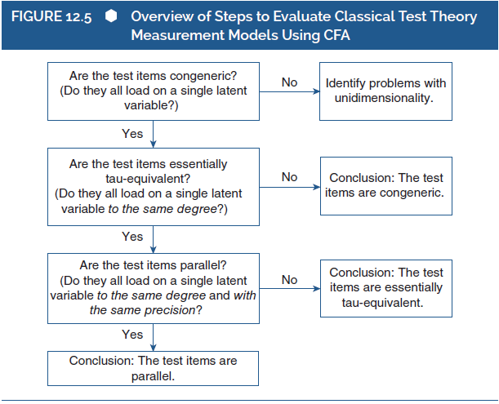
CFA and Reliability (3 of 7)
Evaluating Types of CTT Measurement Models
Notes:
Figure 12.5: Overview of steps to evaluate classical test theory measurement models using CFA.

Slide 23
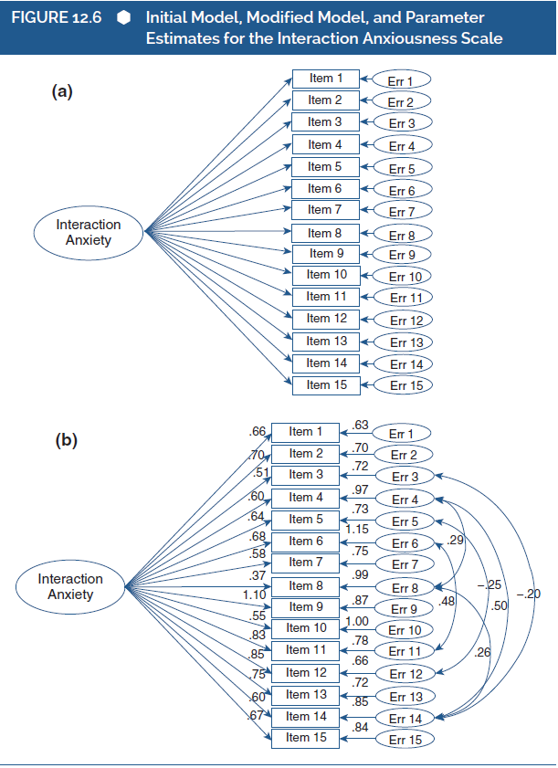
CFA and Reliability (4 of 7)
Evaluating Types of CTT Measurement Models
Notes:
Figure 12.6: Initial model, modified model, and parameter estimates for the Interaction Anxiousness Scale.

Slide 24
CFA and Reliability (5 of 7)
Estimating Reliability (Omega Index)
Methods for estimation.
Evaluating test’s initial measurement model as unidimensional test.
Modifying and reanalyzing measurement model.
Notes:
Methods for estimation: test–retest, alpha, and omega.
Evaluating test’s initial measurement model as unidimensional test:
We can use CFA to do this evaluation.
After evaluation, if we find that the test is not strictly unidimensional, then we move on to the next step.
Modifying and reanalyzing measurement model:
In this step, we identify useful revisions to the model via the modification indices.
We might revise the model to be multidimensional rather than unidimensional.
Or, we might consider relaxing the assumption that the errors are uncorrelated.

Slide 25
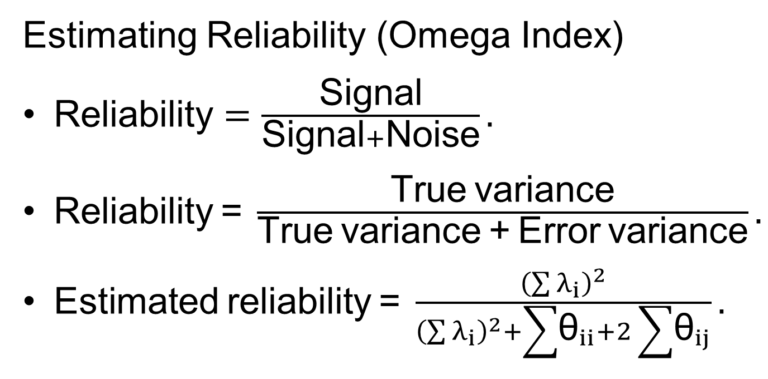
CFA and Reliability (6 of 7)
Estimating Reliability (Omega Index)
$\text{Reliability}=\frac{\text{Signal}}{\text{Signal}+\text{Noise}}.$
$\text{Reliability}\text{ = }\frac{\text{True} \text{variance}}{\text{True} \text{variance}\text{ + }\text{Error} \text{variance}}.$
$\text{Estimated} \text{reliability}\text{ = }\frac{{\left(\sum{λ_{i}}\right)}^{2}}{{\left(\sum{λ_{i}}\right)}^{2}+\sum{{\text{θ}}_{ii}}+2\sum{{\text{θ}}_{ij}}}.$
Notes:
Reliability: It can be seen as the ratio of signal to noise: $\text{Reliability}=\frac{\text{Signal}}{\text{Signal} + \text{Noise}}.$
Defining reliability: It is defined as follows: $\text{Reliability}\text{ = }\frac{\text{True} \text{variance}}{\text{True} \text{variance}\text{ + }\text{Error} \text{variance}}.$
Theoretical definition of reliability: $\text{Estimated} \text{reliability}\text{ =} \frac{{\left(\sum{λ_{i}}\right)}^{2}}{{\left(\sum{λ_{i}}\right)}^{2}+\sum{{\text{θ}}_{ii}}+2\sum{{\text{θ}}_{ij}}}$ where:
λ_{i} refers to an item’s factor loading.
θ_{ii} refers to an item’s error variance.
θ_{ij} refers to the covariance between the error terms of two items which is zero for models without correlated error terms.
${\left(\sum{λ_{i}}\right)}^{2}$ refers to the sum of the items’ squared factor loadings that reflects the variance of true scores across all items.
∑θ_{ii} + 2∑θ_{ij} reflects random error variance.

Slide 26
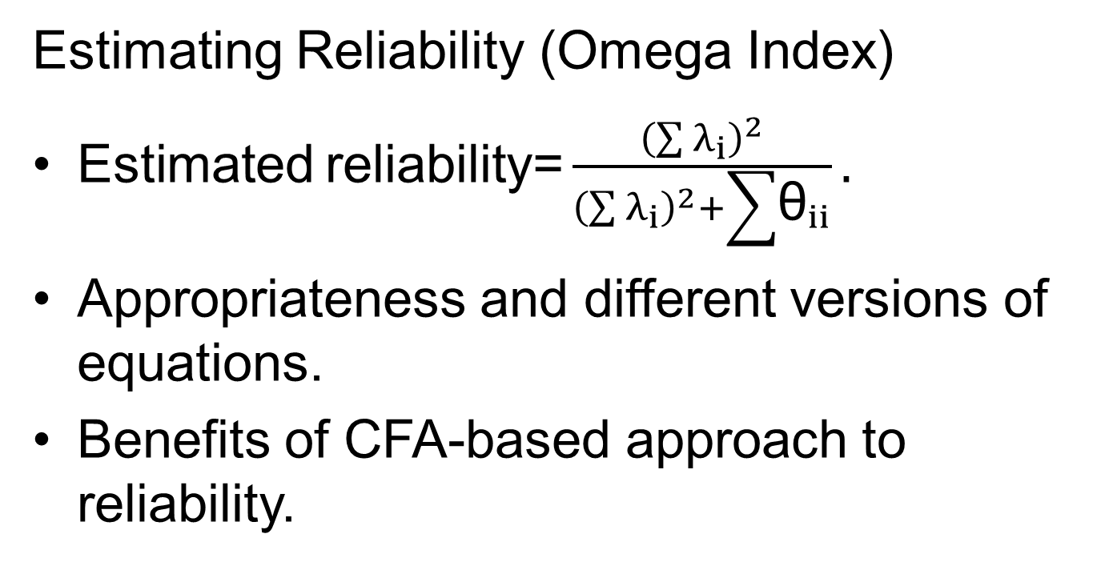
CFA and Reliability (7 of 7)
Estimating Reliability (Omega Index)
$\text{E}\text{stimated} \text{reliability}\text{=}\frac{{\left(\sum{λ_{i}}\right)}^{2}}{{\left(\sum{λ_{i}}\right)}^{2}+\sum{{\text{θ}}_{ii}}}.$
Appropriateness and different versions of equations.
Benefits of CFA-based approach to reliability.
Notes:
Simplified estimated reliability: If we have a good fit for a unidimensional model, then we can simplify the equation for reliability as follows: $\text{Estimated} \text{reliability} \text{=} \frac{{\left(\sum{λ_{i}}\right)}^{2}}{{\left(\sum{λ_{i}}\right)}^{2}+\sum{{\text{θ}}_{ii}}}.$
Appropriateness and different versions of equations:
Both equations of estimated reliability are appropriate when our CFA analysis “fixes” the factor’s variance to 1.0.
Although we often fix factor’s variance to 1.0, it is not necessary to do.
If it is not done, then we can use slightly different versions of these equations that incorporate a term representing the estimated factor variance.
Benefits of CFA-based approach to reliability:
It allows us to estimate reliability in a way that is more widely valid and applicable than the more typical alpha method.
It can go well beyond the relatively simple analysis of unidimensional tests and provide a great range of information about test reliability.

Slide 27
CFA and Validity (1 of 2)
Testing-specific hypothesis about test’s internal structure.
Evaluating test’s association with test responses.
Multitrait–multimethod (MTMM) matrices.
Focused examination of test along with criterion variables.
Notes:
Testing specific hypothesis about test’s internal structure: CFA performs this test and provides insight into the “internal-structure” aspect of validity.
Evaluating test’s association with test responses:
If test responses are collected along with measures of related constructs or criteria, then we can evaluate the test’s association with those variables.
This associative evidence provides important information about the psychological meaning of test scores.
Multitrait–multimethod (MTMM) matrices:
These are used to evaluate convergent and discriminant validity with the help of CFA.
MTMM study includes multiple traits/constructs, each of which is assessed through multiple methods.
By examining the associations among the entire set of scores, we can evaluate convergent validity, discriminant validity, method effects, and other important validity information.
Focused examination of test along with criterion variables:
This also evaluates convergent and discriminant validity with the help of CFA.
Example: Examining the construct validity of the IAS by collecting individuals’ responses along with other measures of their tendency to experience social anxiety.
Through this examination, we can evaluate validity evidence in terms of the association between a test and a relevant criterion, while also accounting for measurement error in both the test and the criterion.

Slide 28
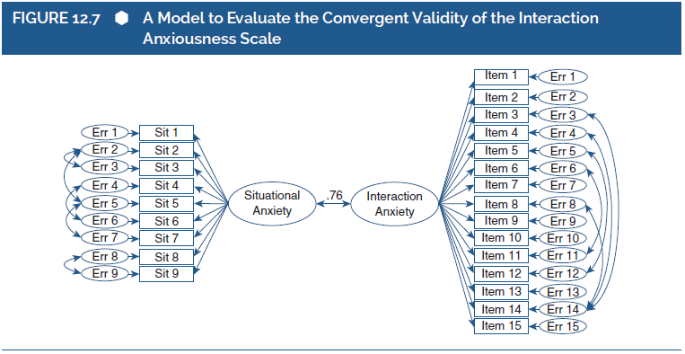
CFA and Validity (2 of 2)
Notes:
Figure 12.7: A model to evaluate the convergent validity of the Interaction Anxiousness Scale.
First, we evaluate the internal structure of the IAS to represent its internal structure.
Second, we evaluate the internal structure of the situational anxiety questionnaire, discovering that two of the situations did not load on a core “situational anxiety” factor.
Third, after clarifying the measurement models for the two questionnaires, we examine the model.
The primary interest is the correlation between the two factors.
The correlation is extremely strong (r = .76) and is statistically significant.

Slide 29
CFA and Measurement Invariance (1 of 7)
The Meaning of Measurement Invariance
Question of construct bias.
Evidence for and against construct bias.
Satisfaction with Life Scale: SWLS.
Cross-cultural work with the SWLS.
Notes:
Measurement invariance: refers to the question of construct bias, whether the internal structure is “invariant.”
Evidence for and against construct bias:
If the test’s internal structure varies across groups, then there is evidence for construct bias.
This suggests that items are not operating in the same psychological way in the two groups.
If the test’s internal structure does not vary across groups, then there is evidence against construct bias.
This suggests that the test’s items are operating in the same psychological way in the two groups.
Satisfaction with Life Scale (SWLS):
It assesses an individual’s global evaluation of the quality of her or his life.
It includes five items that are phrased as statements to which a person rates her or his amount of agreement.
It has been used extensively in psychological research.
Cross-cultural work with the SWLS:
The SWLS can provide clear and meaningful insights into the differences between cultures when its psychometric properties are invariant across cultures.
A study by Tucker and her colleagues evaluated the SWLS’s cross-cultural measurement invariance by comparing SWLS responses from students in the United States and Russia.

Slide 30
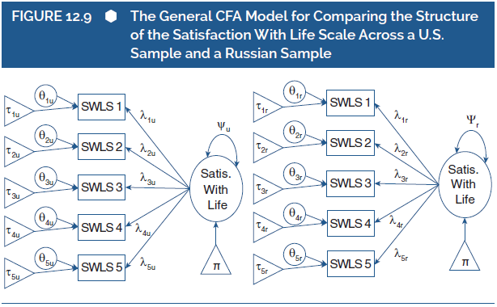
CFA and Measurement Invariance (2 of 7)
The Meaning of Measurement Invariance
Notes:
Figure 12.9: The general CFA model for comparing the structure of the satisfaction with life scale across a US sample and a Russian sample.
In this figure, the lambda (λ) values represent factor loadings for each item within each group.
The theta (θ) values represent error variances for each item within each group, and they are closely linked to the reliability of each item.
The triangle and tau (τ) parameters represent intercepts for each item.
We can evaluate invariance by comparing these parameters across groups.
If different groups have the same value for a given parameter, then this is evidence of invariance on that parameter.
If different groups have different values for a parameter, then this is evidence of a lack of invariance on that parameter.

Slide 31
CFA and Measurement Invariance (3 of 7)
Levels of Invariance: Meaning and Detection
Examination of measurement invariance.
Configural invariance: least robust level.
Testing for configural invariance: MGCFA.
Drawback of configural invariance.
Notes:
Examination of measurement invariance:
It involves comparing groups in terms of sets of parameters, with different sets being compared in different CFA models.
It also involves comparisons of up to four measurement models which reflect four increasingly robust levels of measurement invariance.
Configural invariance: least robust level:
This level is achieved if the number of factors across groups is the same and the pattern of factor loadings is the same.
If this invariance is met, then we can conclude that the test’s items likely reflect the same latent variable across groups.
Testing for configural invariance: multigroup CFA (MGCFA):
It is a special application of CFA.
In this case, it examines measurement models in more than one group at a time and compares groups in terms of the models’ parameters.
Drawback of configural invariance:
It provides little basis for using a test to compare groups on the psychological characteristic assessed by its items.
Even if a scale reflects the same latent variable across groups, the groups might still prevent meaningful comparisons.

Slide 32
CFA and Measurement Invariance (4 of 7)
Levels of Invariance: Meaning and Detection
Weak/Metric invariance: more robust than configural invariance.
Testing for weak/metric variance.
Drawback of weak/metric variance.
Notes:
Weak (or metric) invariance: more robust that configural invariance:
This level is achieved if the number of factors across groups is the same, the pattern of factor loadings is the same, and the exact values of the factor loadings are the same.
If this invariance is met, then we can conclude that the test’s items likely reflect the same latent variable across groups and scale scores are on the same measurement metric.
Testing for weak/metric variance:
In this case, MGCFA is used to constrain factor loadings to be equal across groups.
If the factor loadings are different across groups, then the constraints will lead to a significant decrease in the fit of the model as compared to configural invariance model.
If the factor loadings are similar across groups, then the constraints will not lead to a significant decrease in the fit of the model as compared to configural invariance model.
Drawback of weak/metric variance:
It is not sufficient for proper comparisons of group differences in means.
Hence, an even more robust level of invariance is required.

Slide 33
CFA and Measurement Invariance (5 of 7)
Levels of Invariance: Meaning and Detection
Strong/Scalar invariance: more robust than weak/metric invariance.
Item’s intercept: average person on latent variable.
Testing for strong/scalar invariance.
Notes:
Strong (or Scalar) Invariance:
This level is achieved if the number of factors across groups is the same, the pattern of factor loadings is the same, the exact values of the factor loadings are the same, and the item intercepts are the same.
If this invariance is met, we can conclude that if two people from different groups have the same level of the latent variable, then they will make the same response to the items, on average.
Item’s intercept:
The average response given by someone who has a “zero” on the latent variable.
Often scaled so that this means someone who is average on the latent variable.
Testing for strong/scalar invariance:
In this case, MGCFA is used to constrain items’ factor loadings and intercepts to be equal across groups.
If the strong/scalar model fits worse than the weak/metric model, then we can conclude that the test does not meet criteria for strong/scalar invariance.

Slide 34
CFA and Measurement Invariance (6 of 7)
Levels of Invariance: Meaning and Detection
Strict invariance: most restrictive and robust.
Unique error variance of an item.
Testing for strict invariance.
Notes:
Strict Invariance: This level is achieved if the number of factors across groups is the same, the pattern of factor loadings is the same, the exact values of the factor loadings are the same, the item intercepts are the same, and the items’ unique error variances are the same.
Unique error variance of an item: The variability in an item that is unrelated to variability in the latent variable.
Testing for strict invariance:
In this case, MGCFA is used to constrain factor loadings, intercepts, and unique error variances to be equal across groups.
If the strict model fits worse than the strong/scalar model, then we can conclude that the test does not meet criteria for strict invariance.

Slide 35
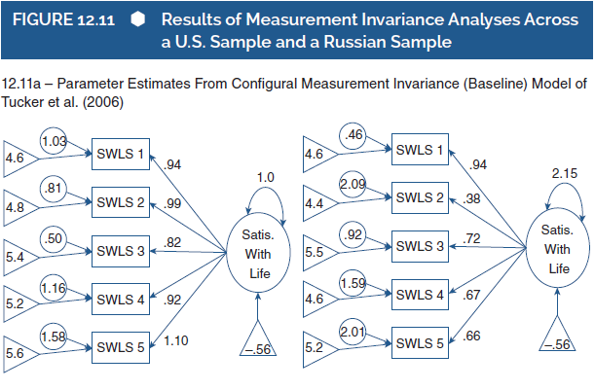
CFA and Measurement Invariance (7 of 7)
Levels of Invariance: Meaning and Detection
Notes:
Figure 12.11: Results of measurement invariance analyses across a US sample and a Russian sample.
Source: Tucker et al. (2006).

Slide 36
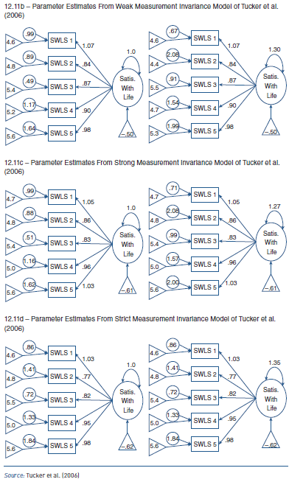
CFA and Measurement Invariance
(7 of 7)
Levels of Invariance: Meaning and Detection
Notes:
Figure 12.11: Results of measurement invariance analyses across a US sample and a Russian sample.
Source: Tucker et al. (2006).

